Slide 1
Stable Diffusion

Slide 2
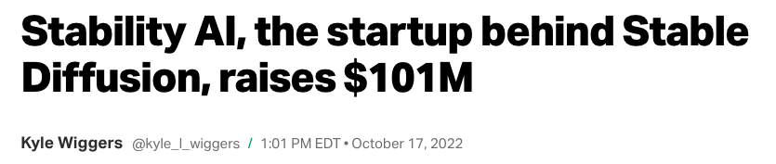
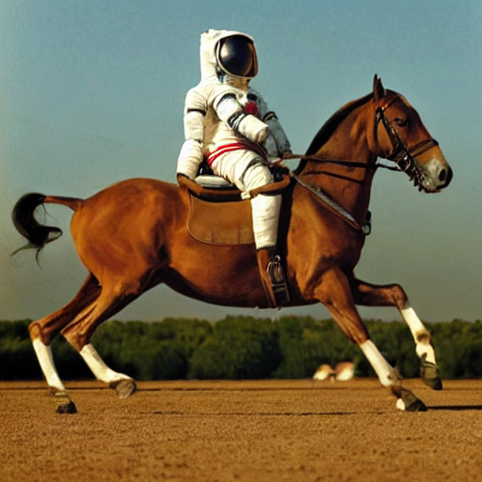
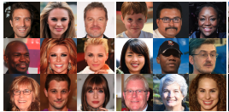
Stable Diffusion
Notes:
Emad Mostaque – Founder Stability AI
Spent $600K of 10MM seed training
“We figured out how to make humans scale”

Slide 3
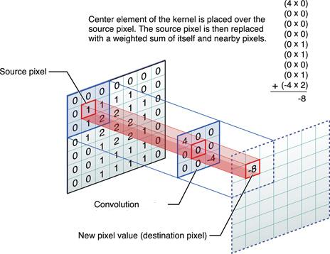
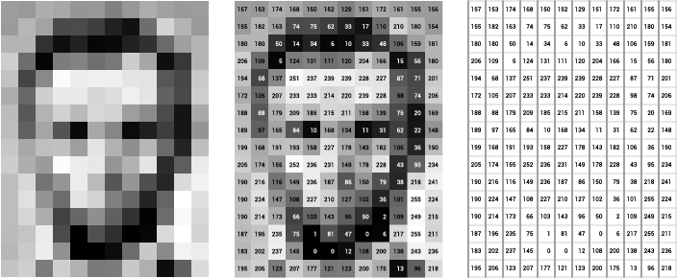
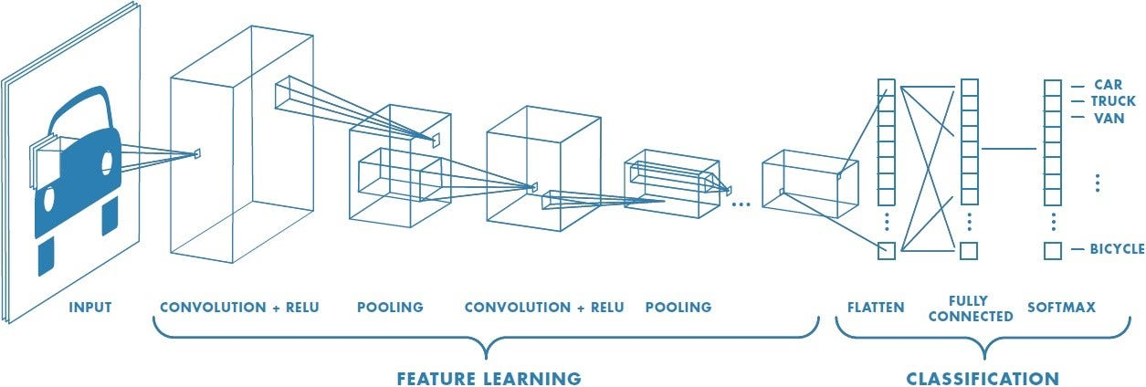
Convolutions

Slide 4
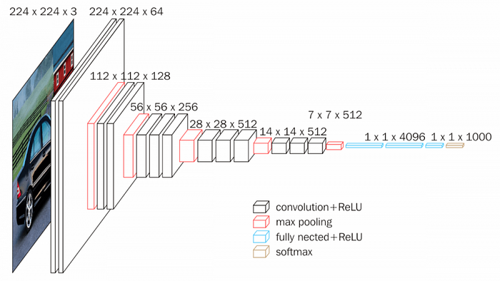
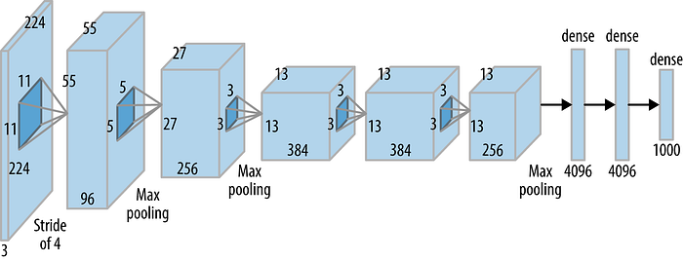
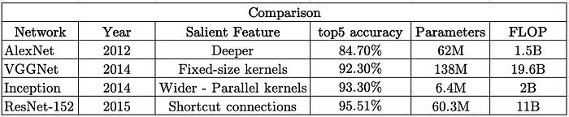
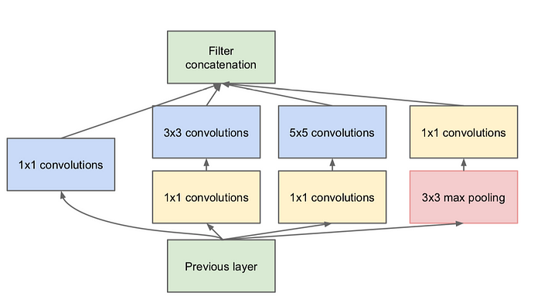
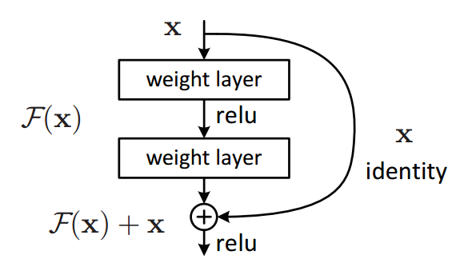
AlexNet + VGG16 + ResNet + Inception
Notes:
AlexNet = Ilya Sutskever - Alex Hinton - Toronto Labs - ImageNet 2012
VGG16 - Smaller Receptive (3x3 - Stride 1)
ResNet - Identity Connections - Key to very deep, 1D Conv
Inception - Multiple receptive fields -- Inception Trains as fast as AlexNet 1/10 Mem

Slide 5
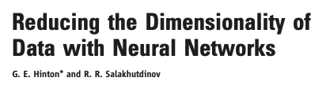
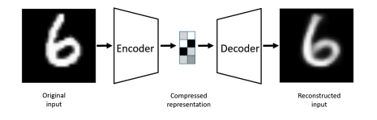
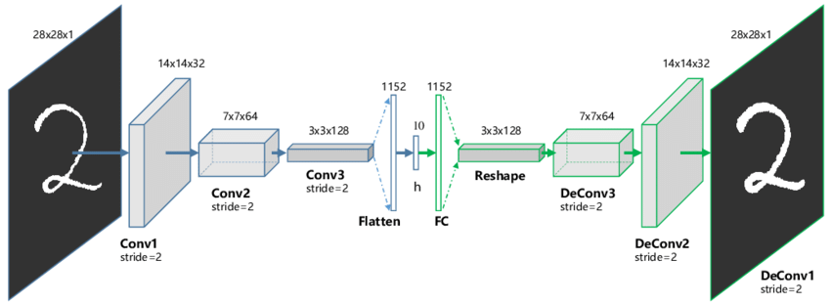
AutoEncoder

Slide 6
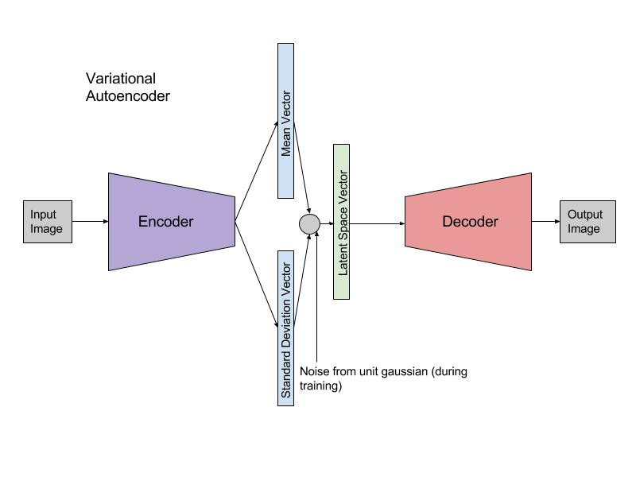
Variational AutoEncoder

Slide 7
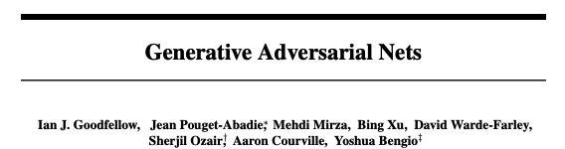
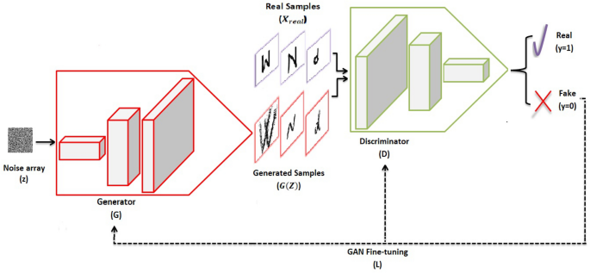
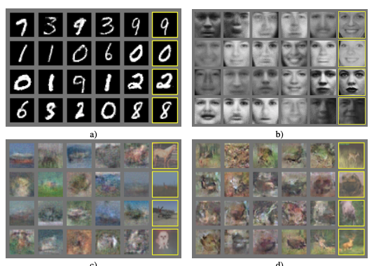
GAN
Notes:
Goodfellow
Schmidhuber

Slide 8
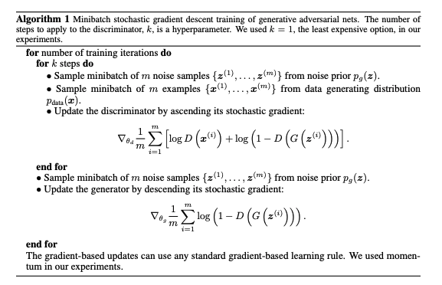
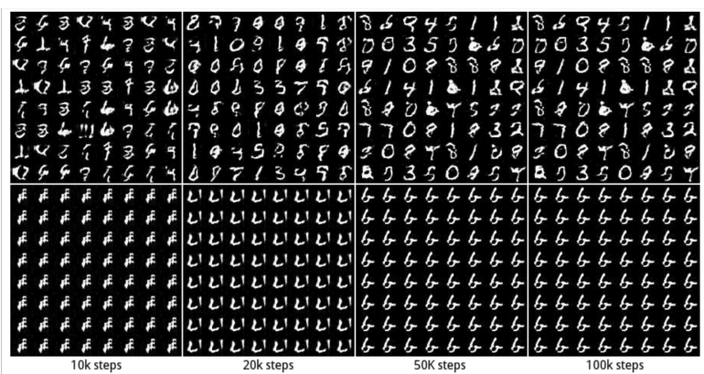
GAN
Notes:
Binary Cross Entropy
Real vs Fake
Train Discriminator (F, R)
Train Generator (
Training Challenges
Mode Collapse - All mass on 1 point
Oscillation - Large changes but not converging

Slide 9
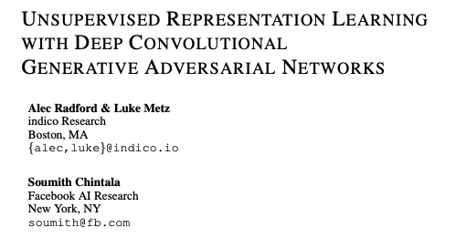
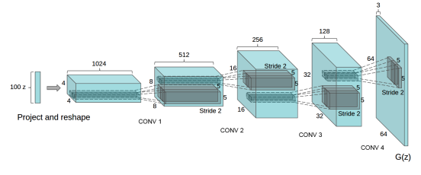
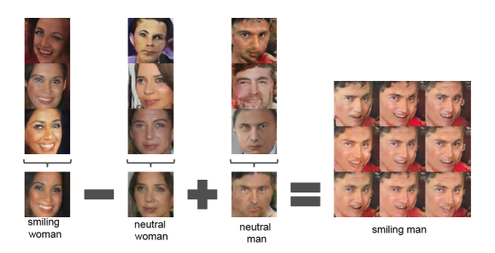
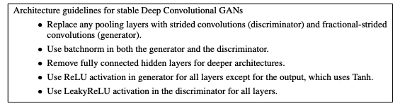
DCGAN
Notes:
Reducing Channels -- Increasing H & W
Vector Math of Images!
Recommendations for Training Deep Conv GANs (Images)

Slide 10
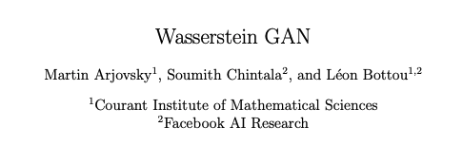
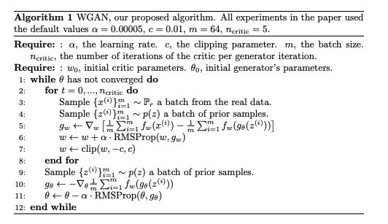
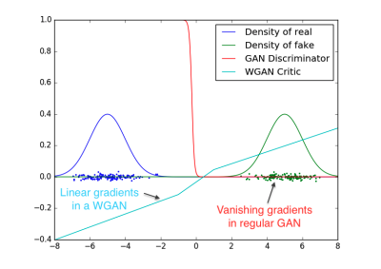
WGAN
Notes:
WGAN - Tackle Vanishing Gradients
Change from D&G to Critic Loss Train Batches - Minimize Loss (Real - Fake)
Change to -1 and 1 for labels
Train critic multiple times for each update of Generator
Clip weights (Sad)
Further Improvements Look at WGAN-GP (Gradient Penalty)
Drop BatchNormalization
Gradient Penalty
Stop Clipping

Slide 11
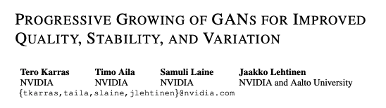
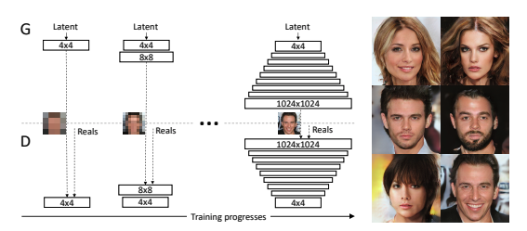
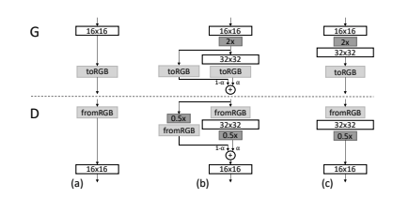
ProGAN
Notes:
Progressive Training - Intuition
Discriminator has it extremely easy (Fake v Real)
Put them on common ground (Get closer to Latent Space)
Expand gradually the Latent Space
Skip-Connection (Routing over an alpha parameter - Dynamic vs Static Graphs)
Images even more lifelike!!!

Slide 12

WambsGAN

Slide 13
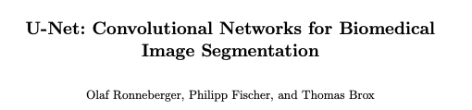
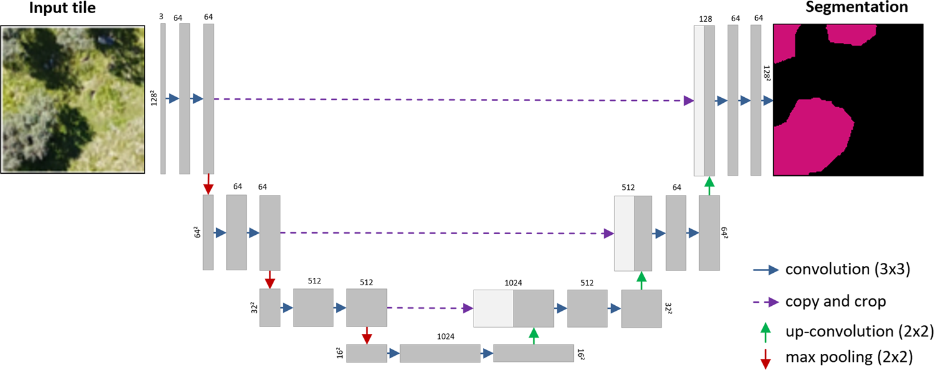
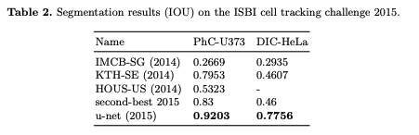
Segmentation - UNet
Notes:
Move to Pixel Space & Semantic Segmentation
Paper 2015
Bowl-Shaped Network -- Copy "across" Skip Connection

Slide 14
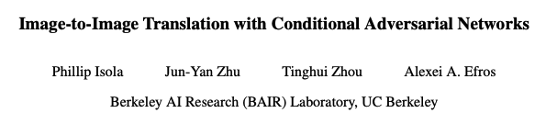
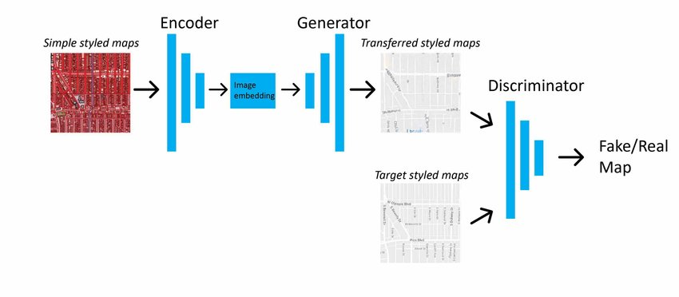
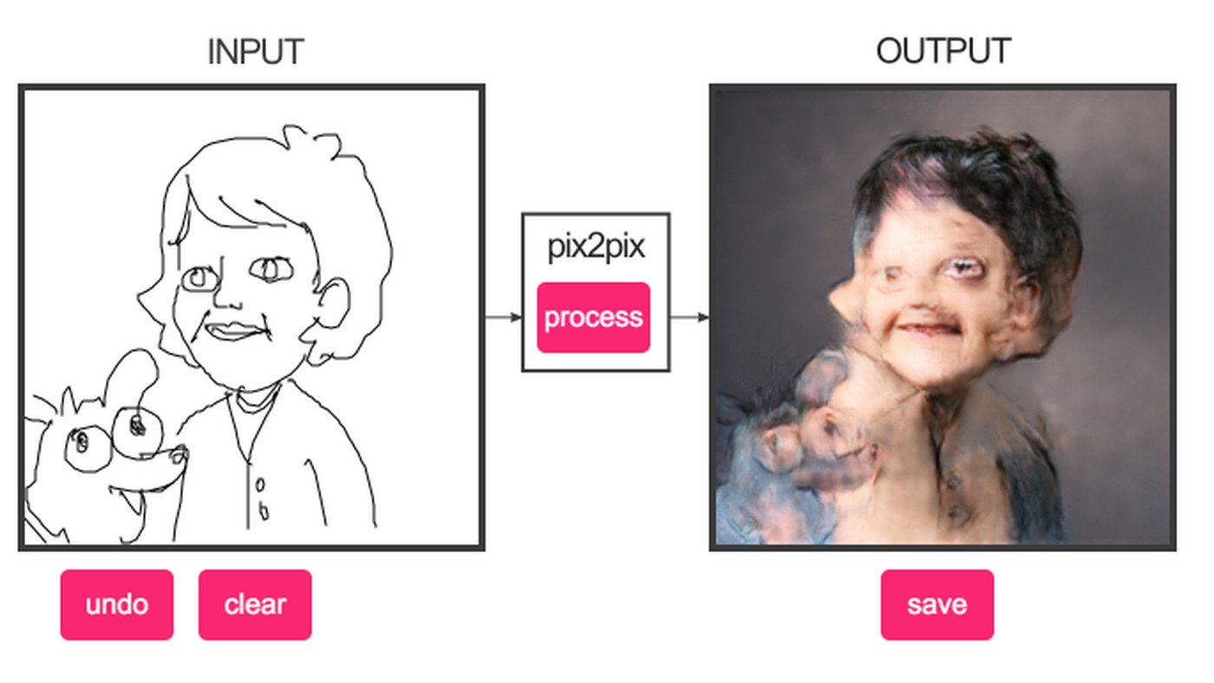
Pix2Pix
Notes:
GAN Architecture
Style Transfer (Take reference to latent space)
Two architectural concepts:
UNet - Generator -- Segmentation
PatchGAN - Disriminator - NxN part of image is fake or real
PatchGAN think form of style / texture loss

Slide 15
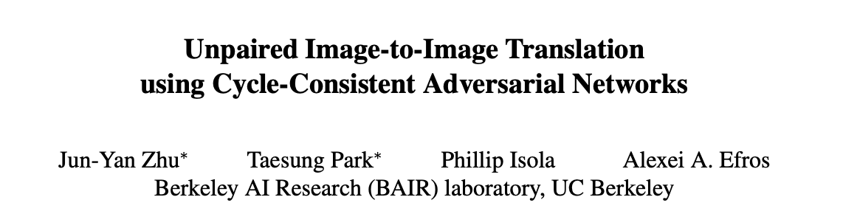
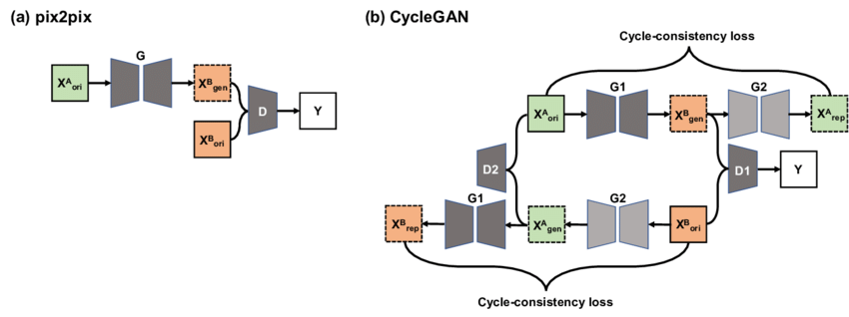
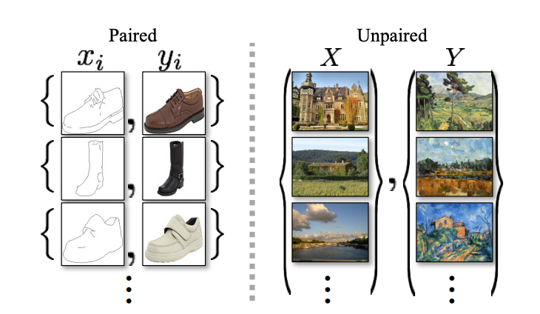
CycleGAN
Notes:
In contrast to Pix2Pix where we learn representation in 1 direction
CycleGAN Maps A->B and B-> A
Operates on UnPaired Images (We don't need labeled data)!!!
Note: Zhu & Isola -- Authors of Pix2Pix
Think of the paper as an unsupervised improvement!

Slide 16
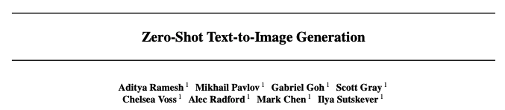
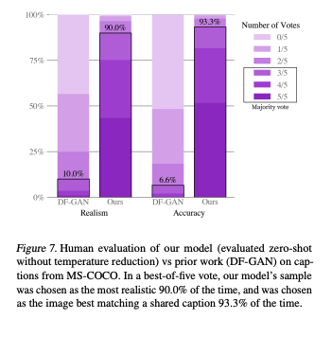
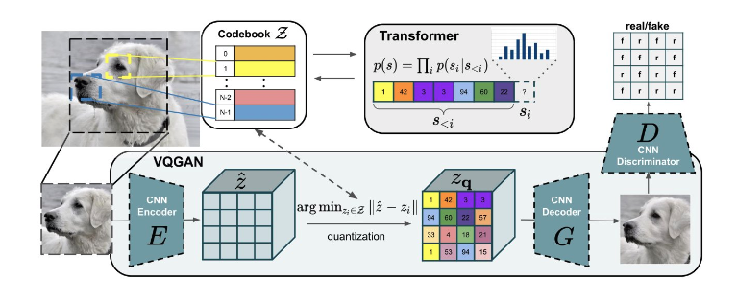
DALL-E 1
Notes:
VQGAN - Vector Quantized (Hear Quantization -- Think Hashing)
Codebook - These are "patches" or hashes
Prior Work Comparison DF-GAN
-- Simple & Effective Baseline for Text-To-Image Synthesis
MS-COCO - Image Segmentation & Captioning Dataset
Names on the Paper (Sutskever, Radford)...

Slide 17
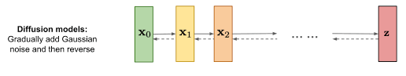
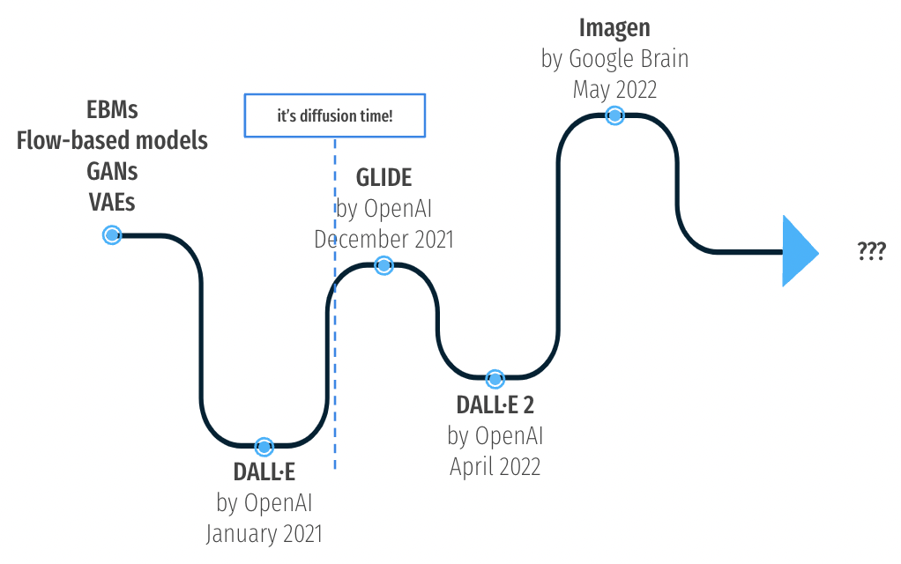
Diffusion

Slide 18
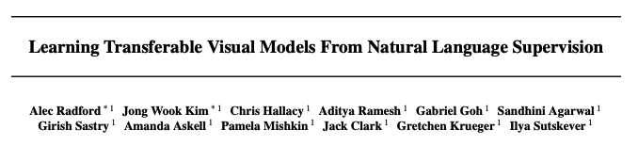
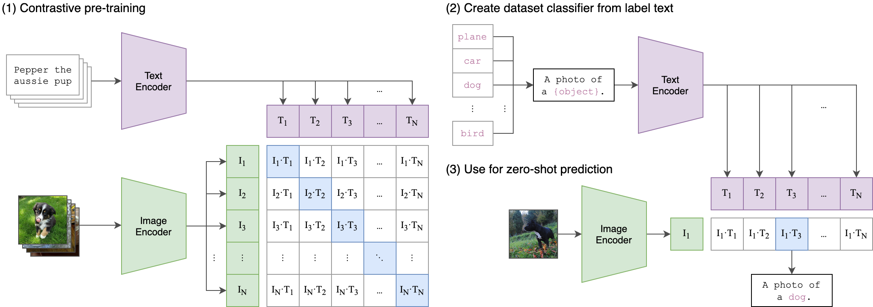
CLIP
Notes:
CLIP - Contrastive Language - Image Pre-training
Train on image - text pairs
Predict the most relevant text snip fiven an image without optimizing for the task!
CLIP == Performance of ResNet50 on ImageNet (Zero Shot) -- No labels
Image Encoder = Resnet50
Text Encoder - CBOW or Transformer (GPT-2/3)
Large Dataset 400 Million Images (Alt Text)

Slide 19
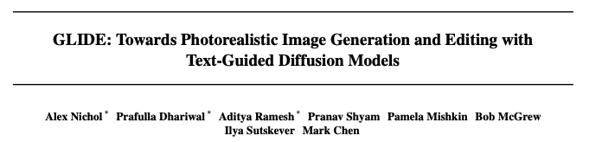
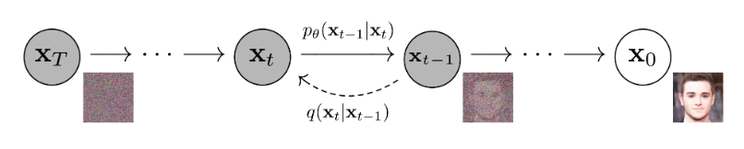
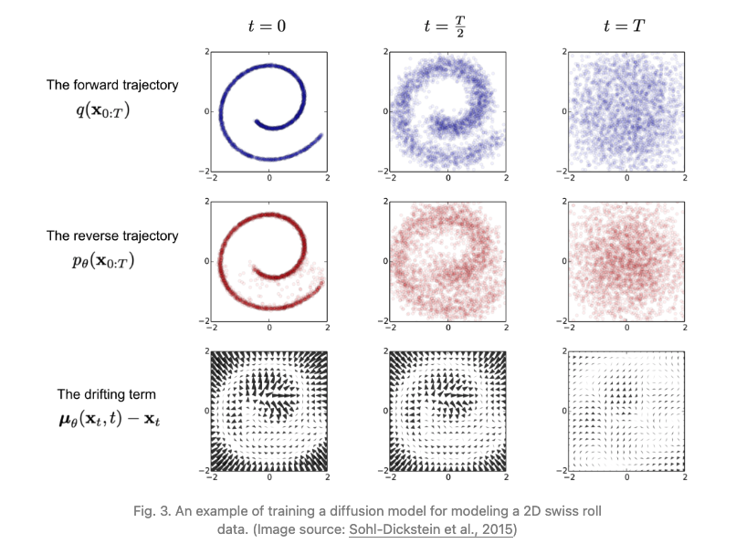
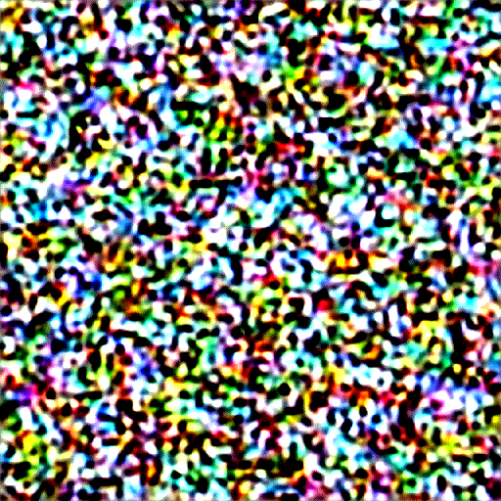
Glide
Notes:
Text-Guided Diffusion Model for more photo realism
Uses text encoder to condition on Nat Lang Descriptions
Model achieves editing capabilities, zero shot generation, fine-tuned for inpainting
Uses diffusion models explores
* Guided diffusion – Improve sample quality vs diversity (Class conditional diffusion model)
* CLIP guidance – Score how close an image and description is (replace classifier with CLIP)
* Classifier-Free Guidance – No separate classifier

Slide 20


DALL-E 2
Notes:
Generative text-to-image
Generate a CLIP image embedding
Decoder creates / generates image conditioned on image embedding “unclip”
Diffusion is used for the decoder (i.e. Diffusion Prior)

Slide 21




Imagen
Notes:
COCO-FID --> Frechet Inception Distance (Evaluation Metric for GANS)
Distance between 2 distributions of images - measure quality of generative AI)
T5 -> It's Google
Scores
* Supervised vs Unsupervised
* AttnGAN (Old -- Beginning of the Deck) -> Pretty Good by the end
* DF-GAN --> DALLE --> GLIDE --> DALLE2 --> Imagegen)
* Remarkable --> Imagen (outperforms Supervised)

Slide 22


Stable Diffusion

Slide 23

Legal – Getty vs Stable Diffusion

